Slide 1







Final Assigment - Applied Capstone
Joel Caristan Kamlo
Tuesday, May 24th, 2022

Slide 2



OUTLINE
Executive Summary
Introduction
Methodology
Results
Visualization – Charts
Dashboard
Discussion
Findings & Implications
Conclusion
Appendix

Slide 3

EXECUTIVE SUMMARY
In this capstone, we will predict if the Falcon 9 first stage will land successfully, by using several machine learning methodologies.
Main steps on this capstone include :
Data collection, wrangling, formatting
Exploratory Data Analysis
Data Visualization (Matplotlib & Dash)
Machine Learning
The interactive dashboard allows us to know, which site has the largest successful launches
Graphs obtained, show that some features of Falcon 9 rocket launches, have a correlation with the outcome of launches, ie, success or failure.
We can conclude that decision tree may be the best machine learning algorithm to predict if the Falcon 9 first stage will land successfully.

Slide 4

INTRODUCTION
In this capstone, we will predict if the Falcon 9 first stage will land successfully. SpaceX advertises Falcon 9 rocket launches on its website with a cost of 62 million dollars; other providers cost upward of 165 million dollars each, much of the savings is because SpaceX can reuse the first stage.
Therefore if we can determine if the first stage will land, we can determine the cost of a launch. This information can be used if an alternate company wants to bid against SpaceX for a rocket launch.
In this capstone, we will collect and make sure the data is in the correct format from an API, then explore, analyse and prepare the data to answer the main question.
The main questions to answer are :
For a given set of features of Falcon 9 rocket launches, will the first stage of the rocket land successfully ?
Are there a correalation between features of the Falcon 9 rocket and the outcome of launches (success or failure) ?

Slide 5

METHODOLOGY
Data Collection, Wrangling and Formatting
SpaceX API
Web Scrapping
Exploratory Data Analysis (EDA)
Pandas & Numpy
SQL
Interactive Data Visualization
Matplotlib and Seaborn
Folium
Plotly Dash
Machine Learning
Logistic Regression (LR)
Support Vector Machine (SVM)
Decision Tree
K-Nearest Neighbors (KNN)

Slide 6
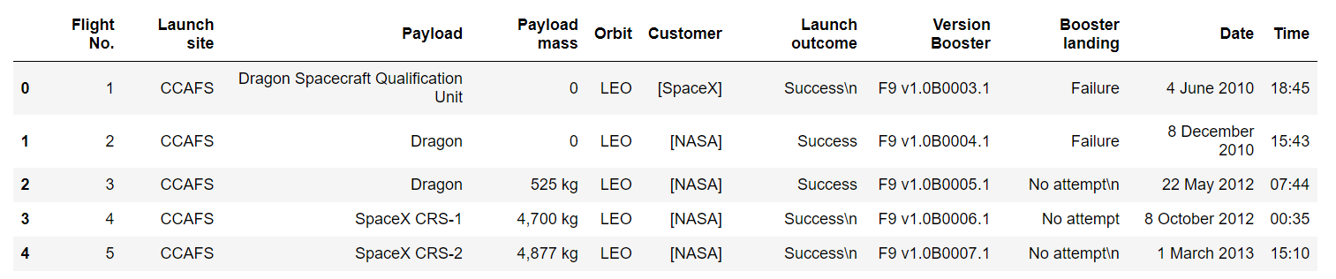
Data Collection, Wrangling and Formatting
METHODOLOGY
Web Scrapping
Data are scraped from https://en.wikipedia.org/w/index.php?title=List_of_Falcon_9_and_Falcon_Heavy_launches&oldid=1027686922
The website contains only data about Falcon 9 launches.
After filtering the data, we have 121 rows (instances) and 11 columns (features)

Slide 7
Data Collection, Wrangling and Formatting
METHODOLOGY
SpaceX API
API used is https://api.spacexdata.com/v4/launches/past
The API provides data for many types of rocket launches done by SpaceX, then data are filtered to include only Falcon 9's rocket launches.
Every missing value is replaced by the mean of the column, where the missing value is belongsto.
After filtering the data, we have 90 rows (instances) and 17 columns (features)
Data is later processed, so that there are no missing entries and categorical features are encoded using one-hot encoding
An extra column called 'Class' is also added to the dataframe. The column class contains 0 if a given launch is failed and 1 if it's successful
At the end we have 90 rows and 83 columns

Slide 8
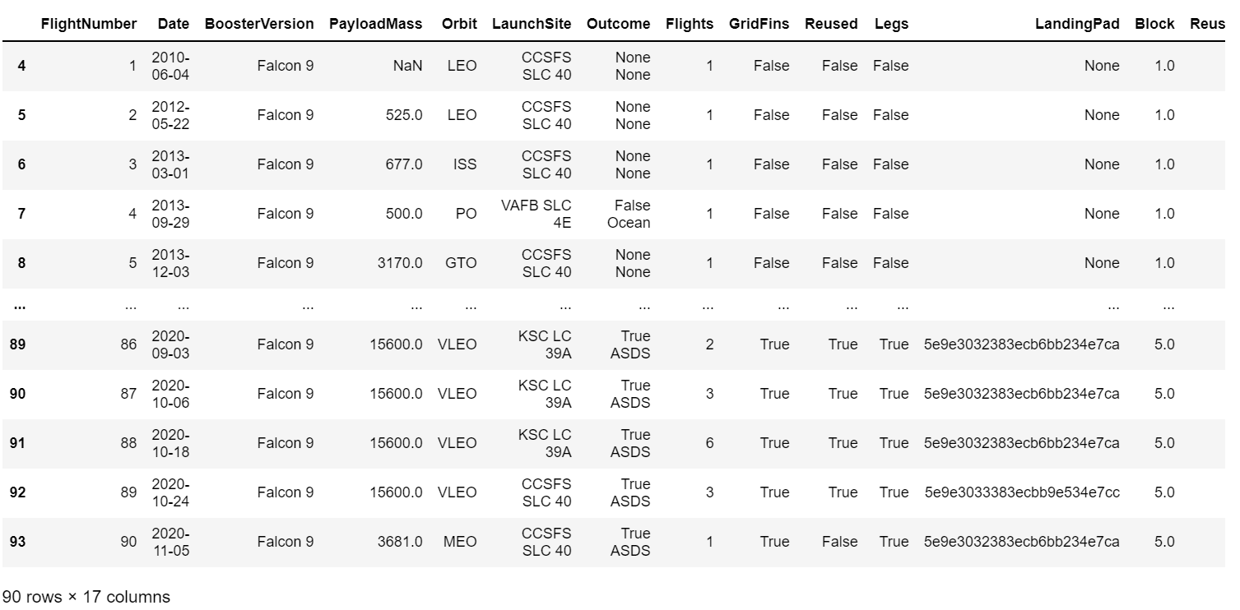
Data Collection, Wrangling and Formatting
METHODOLOGY

Slide 9
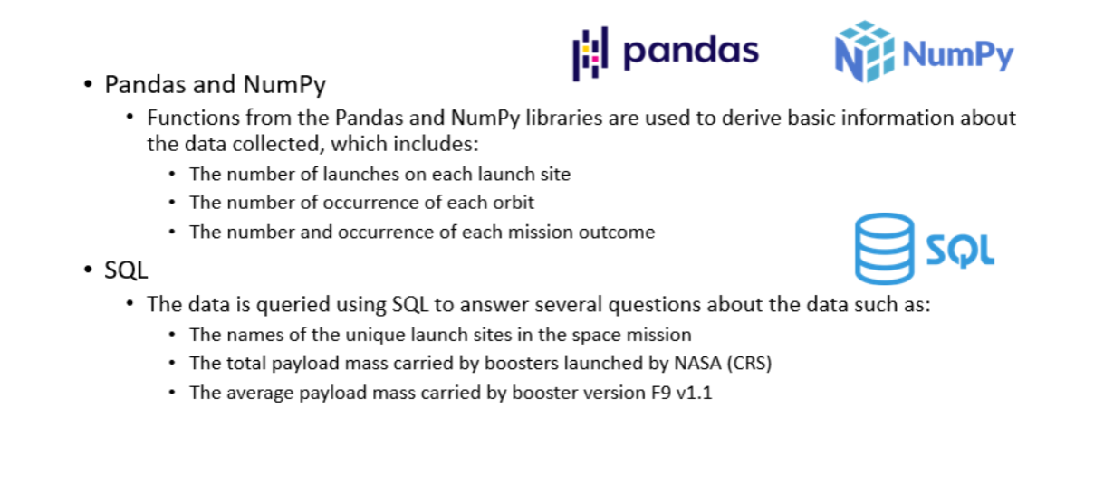
2. Exploratory Data Analysis (EDA)
METHODOLOGY

Slide 10
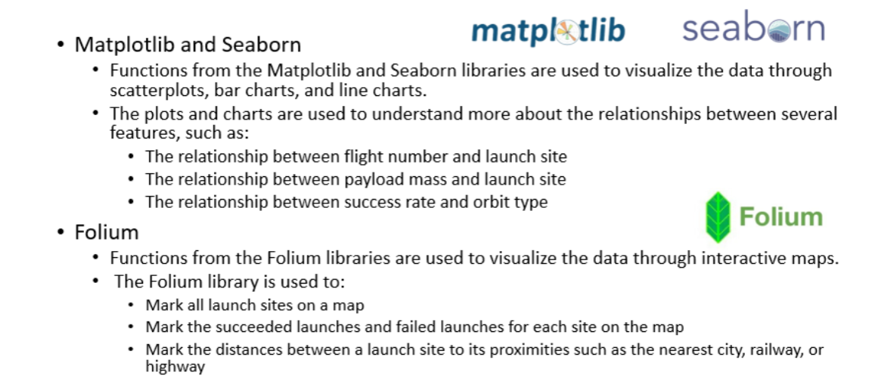
3. Data Visualization
METHODOLOGY

Slide 11
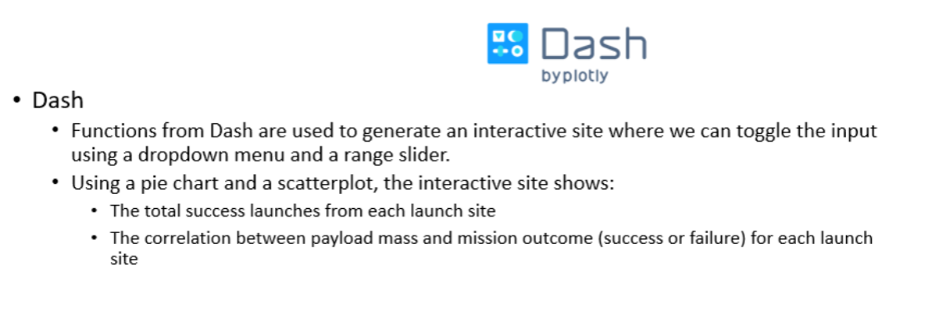
3. Data Visualization
METHODOLOGY

Slide 12
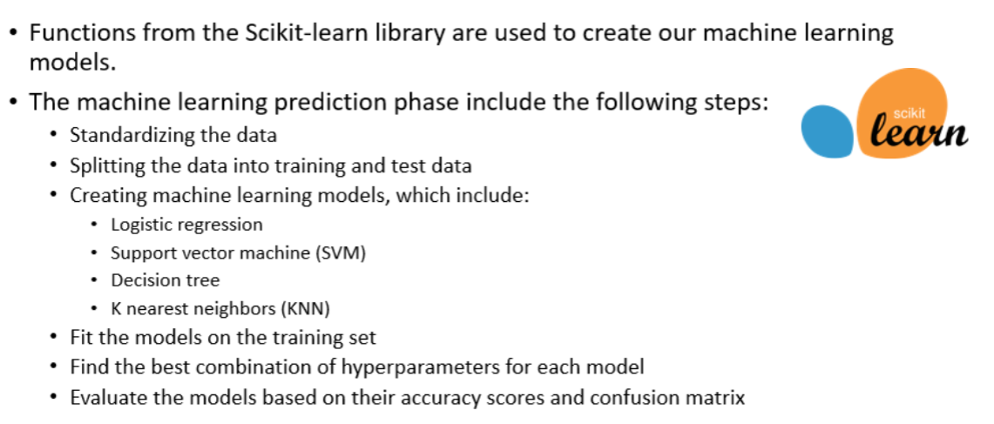
4. Machine Learning
METHODOLOGY

Slide 13
RESULTS
Results are splitted into five(05) sections :
SQL (EDA with SQL)
Matplotlib and Seaborn (EDA with Visualization)
Folium
Dash
Predictive Analysis

Slide 14
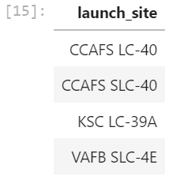
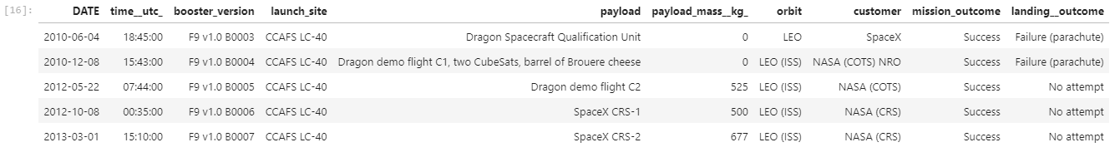
1. SQL (EDA with SQL)
RESULTS
Display the names of the unique launch sites in the space mission
Display the 5 records where launch sites begin with the string 'CCA'

Slide 15
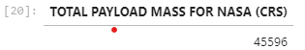
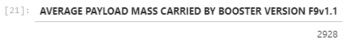
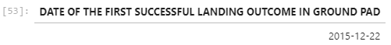
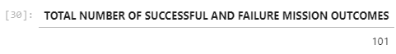
1. SQL (EDA with SQL)
RESULTS
Display the total payload mass carried by boosters launched by NASA (CRS)
Display average payload mass carried by booster version F0v1.1
List the date when the first successful landing outcome in ground pad was acheived
List the total number of successful and failure mission outcomes

Slide 16
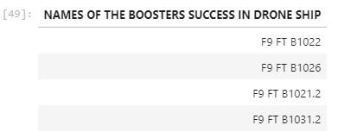
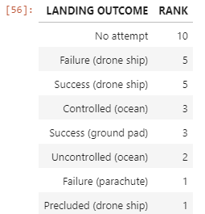
1. SQL (EDA with SQL)
RESULTS
List the names of the boosters which have success in drone ship and have payload mass greater than 4000 but less than 6000
Rank the count of landing outcomes (such as Failure (drone ship) or Success (ground pad)) between the date 2010-06-04 and 2017-03-20, in descending order

Slide 17
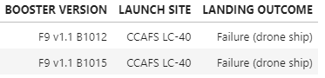
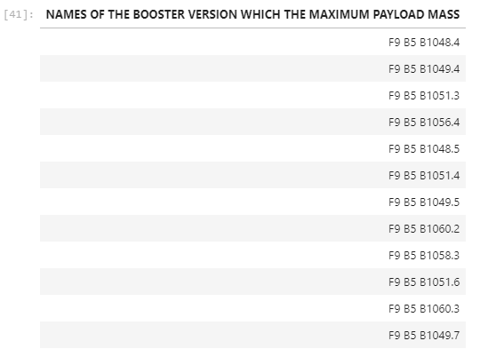
1. SQL (EDA with SQL)
RESULTS
List the failed landing_outcomes in drone ship, their booster versions, and launch site names for in year 2015
List the names of the booster_versions which have carried the maximum payload mass

Slide 18
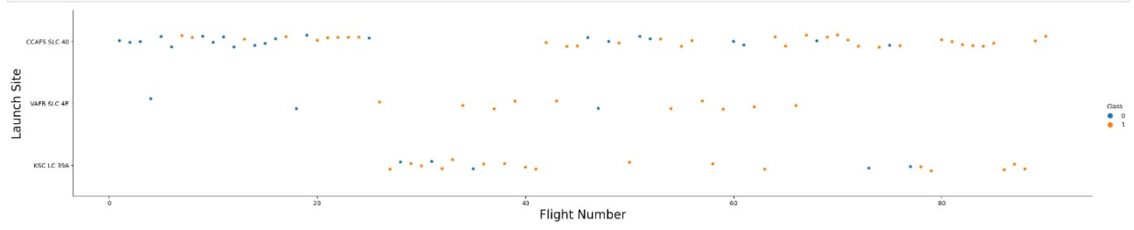
2. Matplotlib & Seaborn (EDA with Visualization)
RESULTS
Visualize the relationship between Flight Number and Launch Site

Slide 19
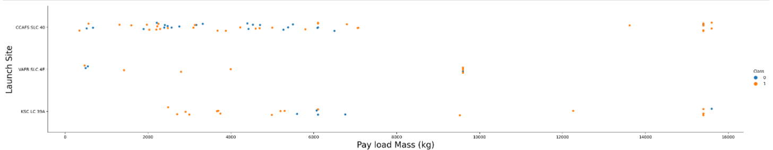
2. Matplotlib & Seaborn (EDA with Visualization)
RESULTS
Visualize the relationship between Payload and Launch Site

Slide 20
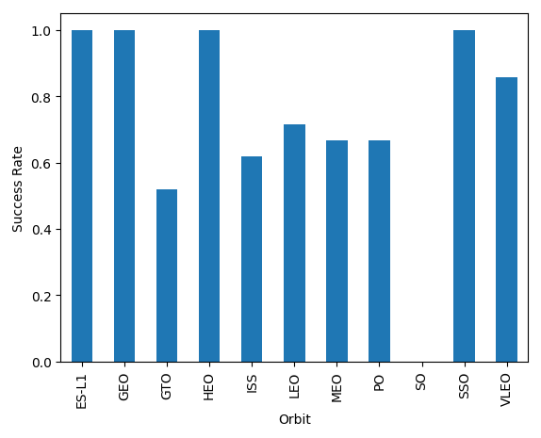
2. Matplotlib & Seaborn (EDA with Visualization)
RESULTS
Visualize the relationship between success rate of each orbit type

Slide 21
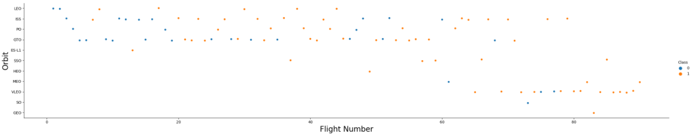
2. Matplotlib & Seaborn (EDA with Visualization)
RESULTS
Visualize the relationship between Flight Number and Orbit type

Slide 22
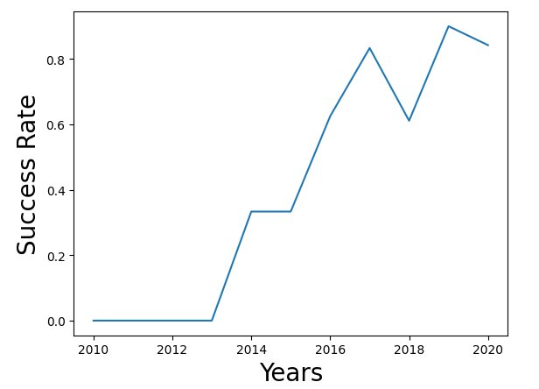
2. Matplotlib & Seaborn (EDA with Visualization)
RESULTS
Visualize the launch success yearly trend

Slide 23
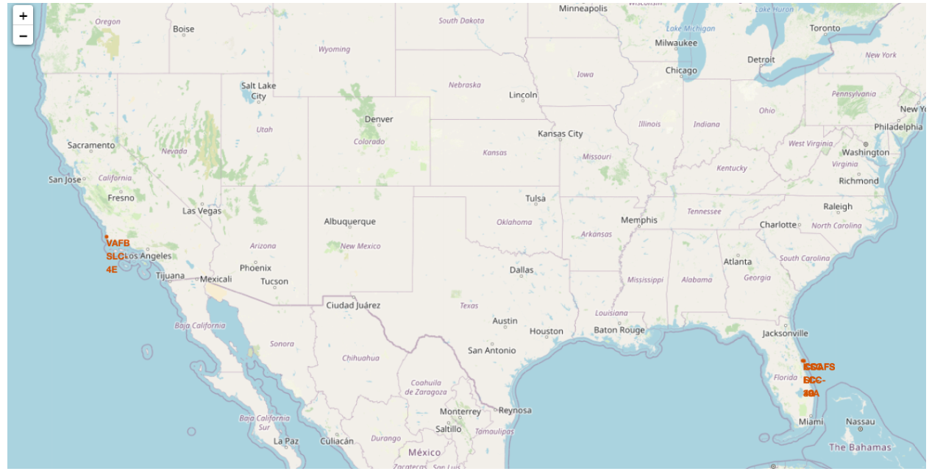
3. Folium
RESULTS
All sites on the map

Slide 24
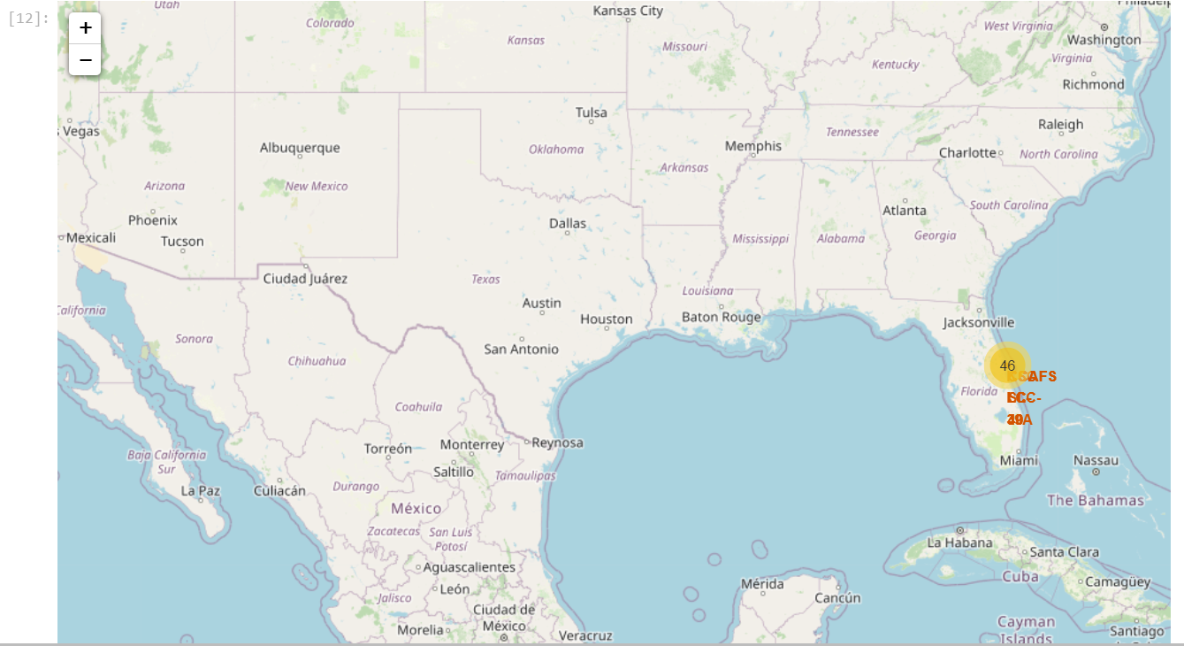
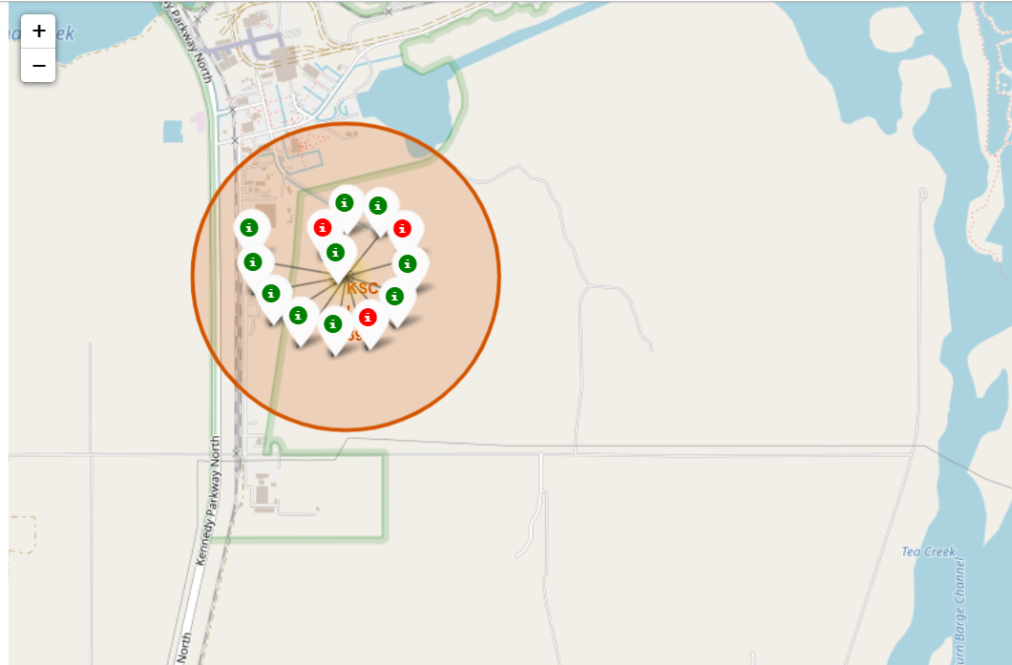
3. Folium
RESULTS
Mark the success/failed launches for each site on the map

Slide 25
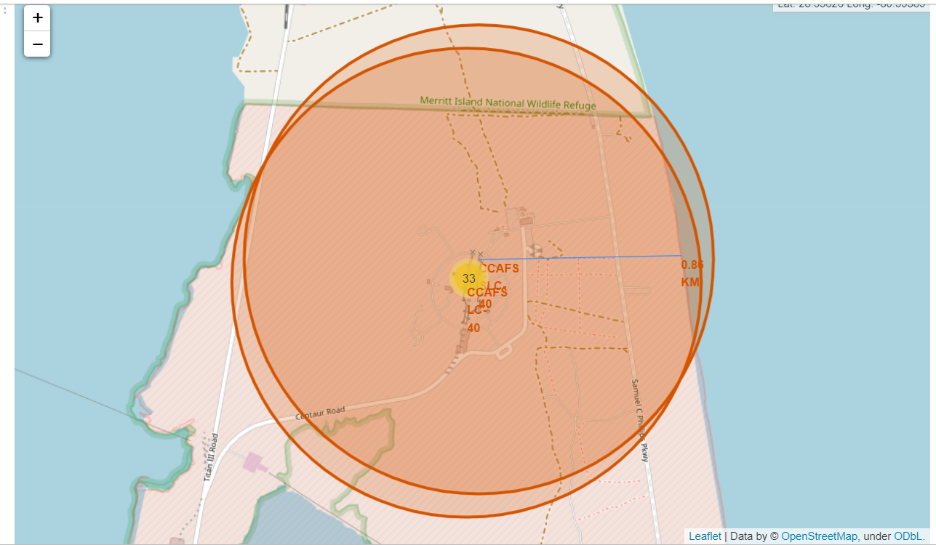
3. Folium
RESULTS
Calculate the distances between a launch site to its proximities

Slide 26
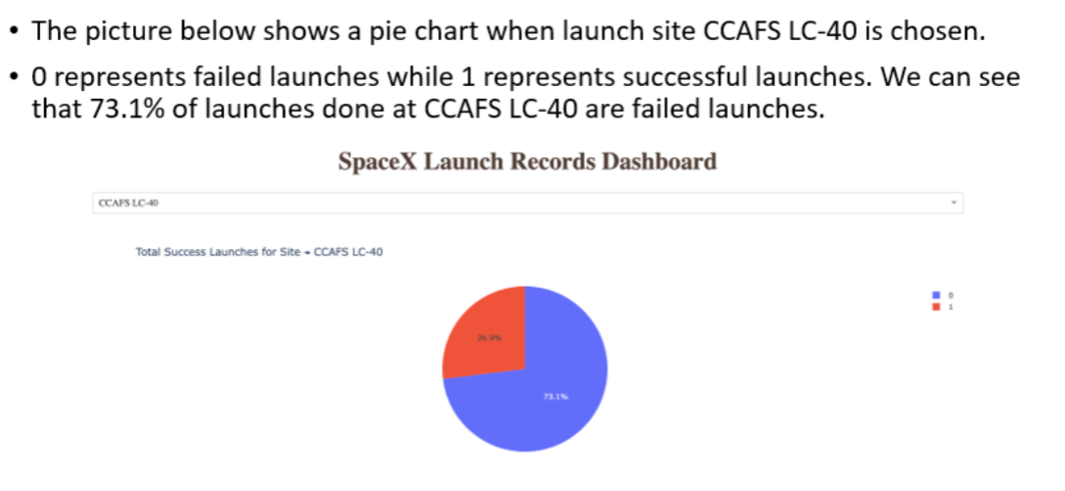
4. Dash
RESULTS

Slide 27
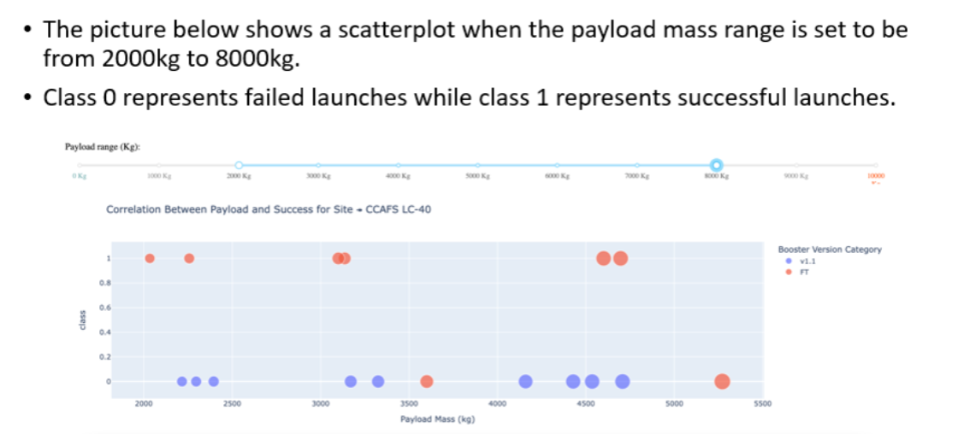
4. Dash
RESULTS

Slide 28
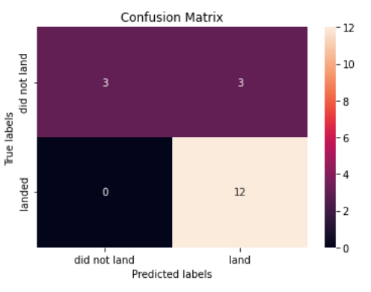
5. Predictive Analysis
RESULTS
Logistic Regression
GridSearchCV best score on train data : 0.8464285714285713
Best paramters : 'C': 0.01, 'penalty': 'l2', 'solver': 'lbfgs'
Accuracy score on test data : 0.8333333333333334
Confusion Matrix :

Slide 29
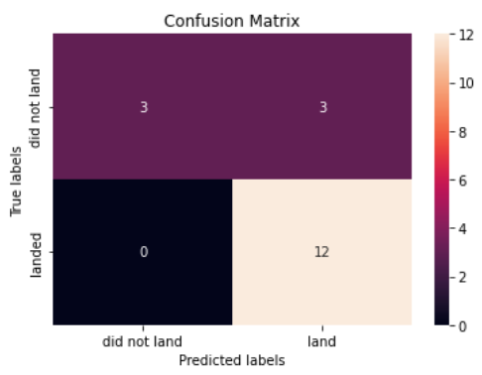
5. Predictive Analysis
RESULTS
Support Vector Machine (SVM)
GridSearchCV best score on train data : 0.8482142857142856
Best paramters : 'C': 1.0, 'gamma': 0.03162277660168379, 'kernel': 'sigmoid'
Accuracy score on test data : 0.8333333333333334
Confusion Matrix :

Slide 30
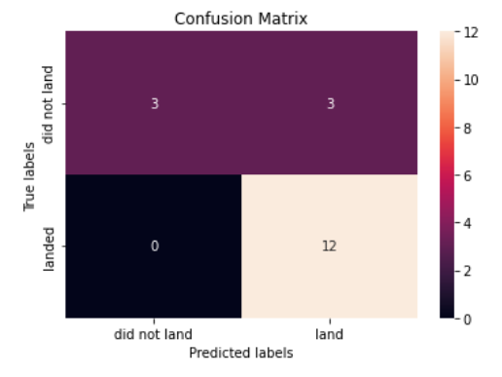
5. Predictive Analysis
RESULTS
Decision Tree
GridSearchCV best score on train data : 0.875
Best paramters : 'criterion': 'gini', 'max_depth': 8, 'max_features': 'auto', 'min_samples_leaf': 1, 'min_samples_split': 10, 'splitter': 'random'
Accuracy score on test data : 0.8333333333333334
Confusion Matrix :

Slide 31
5. Predictive Analysis
RESULTS
K-Nearest Neighbors (KNN)
GridSearchCV best score on train data : 0.8482142857142858
Best paramters : 'algorithm': 'auto', 'n_neighbors': 10, 'p': 1
Accuracy score on test data : 0.8333333333333334
Confusion Matrix :

Slide 32
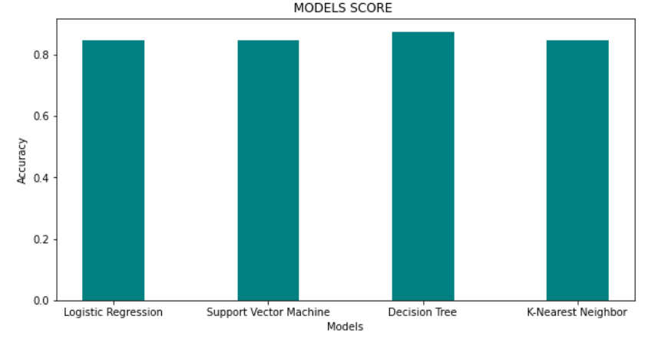
5. Predictive Analysis
RESULTS
Decision Tree is the best classifier to predict if the Falcon 9 rocket , will launch successfully or not

Slide 33

DISCUSSION
From the data visulaization section, we can see that some features may have a correlation with the mission outcome in several days. For example, with heavy payloads,the successfull landing or positive landing rate are more for orbit types Polar, LEO and ISS. However, for GTO, we cannot distinguish well, such as positive and negative landing rate are both presents.
Therefore, each future may have certain impact on the final mission outcome. The exact ways of how each of these features impact the mission outcome are difficult to satisfy. However, we can use some machien learning algorithms to learn the pattern of the past data and predict wether a mission will be successfull or not, based on the given features.

Slide 34

CONCLUSION
In this project, we have try to predict if the first stage of a given Falcon 9 launch will land in order to determine the cost of a launch,
Each feature of Falcon 9 launch, such as payload mass (kg) or orbit type, may affect the mission outcome in certain way,
Several machine learning classifier have been used, to learn the patterns of past Falcon 9 launch data, to produce a predictive model.
By using a new Falcon 9 launch (test data), we outcome with decision tree to be a best classifier to predict if a Falcon 9 rocket launch will land successfully

Slide 35
GITHUB JOB POSTINGS

